Slide 1

HEART DISEASE ANALYSIS
A Data-Driven Approach to Understanding Heart Health

Slide 2

Introduction to the Problem
Heart disease is the leading cause of death globally, responsible for approximately 17.9 million deaths each year (31% of all deaths).
Understanding patterns in heart disease data can help identify high-risk individuals, improve early diagnosis, and guide preventative measures.

Slide 3
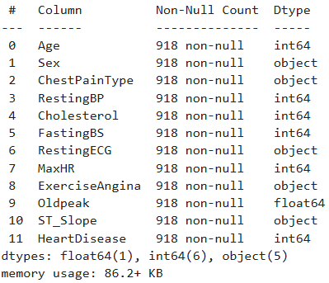
Understanding the Dataset
Data Source: KAGGLE
Data Information:
The dataset contains 918 rows and 12 columns.
Each row represents a patient, and the columns contain health-related features.
The dataset is balanced, with patients both with and without heart disease.
Sample Data Attributes:
ChestPainType : chest pain type [TA: Typical Angina, ATA: Atypical Angina, NAP: Non-Anginal Pain, ASY: Asymptomatic]
RestingBP : resting blood pressure [mm Hg]
HeartDisease : output class [1: heart disease, 0: Normal]

Slide 4

Exploring Key Insights

Slide 5
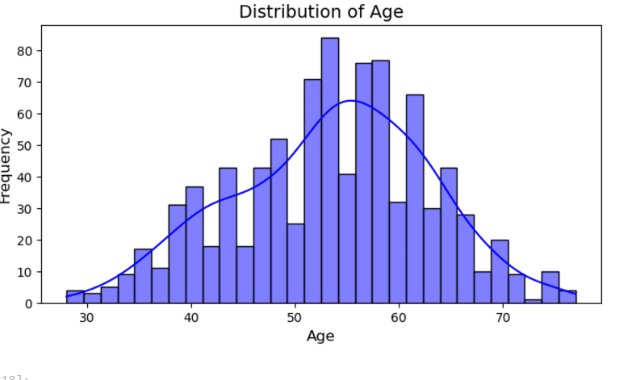
Age Distribution
Age is one of the most significant risk factors for heart disease, as older individuals are more likely to develop cardiovascular problems due to the natural aging process, arterial stiffness, and accumulated risk factors like high cholesterol or hypertension
The dataset shows a normal distribution of ages, peaking around 50–60 years.

Slide 6
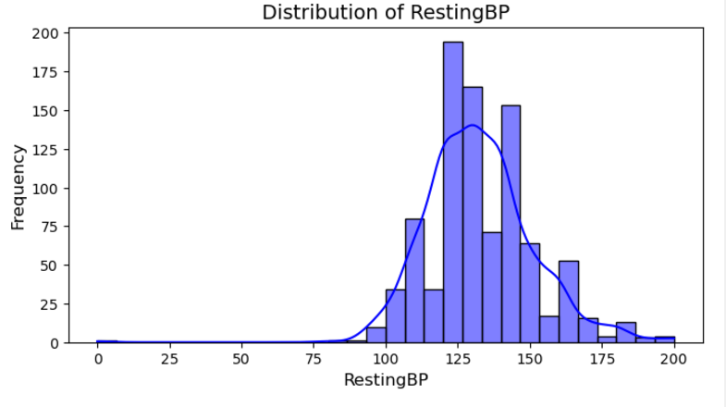
Insights on Resting Blood Pressure Distribution
The distribution of RestingBP is approximately normal, with a peak around 120–130 mmHg
Some have values near or at 0, which might indicate measurement errors or unrecorded data.
Normal or low resting blood pressure does not necessarily rule out heart disease, especially in cases where other risk factors are present.

Slide 7
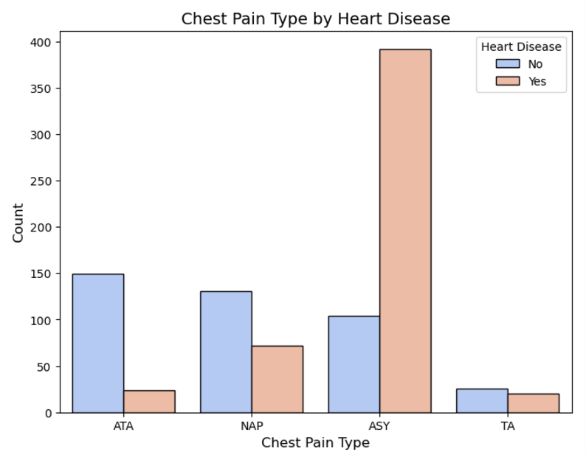
Chest Pain Type by Heart Disease
The Chest Pain Type (ChestPainType) feature categorizes the type of chest pain experienced by patients:
ATA (Atypical Angina): Pain not related to the heart.
NAP (Non-Anginal Pain): Pain that doesn’t seem to be related to the heart.
ASY (Asymptomatic): No chest pain, but other symptoms or signs may indicate heart disease.
TA (Typical Angina): Chest pain caused by reduced blood flow to the heart.
Chest pain is one of the most common indicators used in diagnosing heart disease

Slide 8
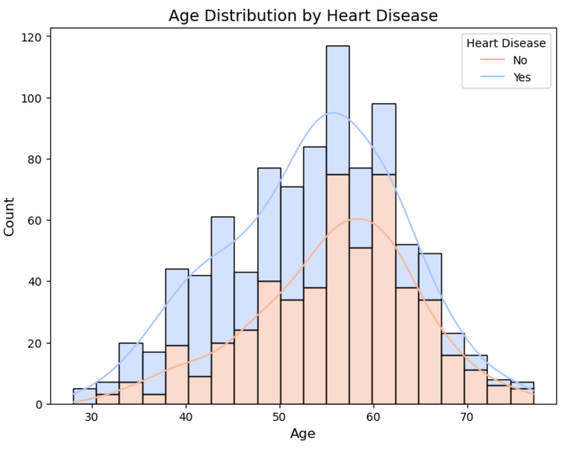
Age vs. Heart Disease
Age is a strong predictor of heart disease, as it directly correlates with physical changes and prolonged exposure to risk factors.
Age often interacts with other factors, such as cholesterol, blood pressure, and exercise tolerance, to amplify the risk of heart disease.
Heart disease is more common among middle-aged and older individuals (ages 50–60), as shown in the histogram for "Age Distribution by Heart Disease.

Slide 9
Conclusion
This analysis highlights the importance of leveraging data to understand heart disease patterns and risk factors.
Key factors such as age, chest pain type, and cholesterol levels have been identified as critical in determining the likelihood of heart disease.
Data is a powerful tool in addressing global health challenges. By analyzing patient data, we can make informed decisions that lead to better health outcomes, improved diagnostics, and more effective treatments.

Slide 10
THANK YOU
Tawakalit Agboola

